Slide 1
Machine Learning Approaches for Network Intrusion Detection: A Comparative Study
TEAM:YUNFEI QUAN,PEIFENG YAO,YULONG WANG,ZE XU,SHUBO WANG
PROF. SUNDEEP RANGAN

Slide 2
Outline
Introduction
Dataset and Problem Formulation
Methodology
Experimental Results

Slide 3

Introduction
With the rapid expansion of networks and the internet, network attack techniques are constantly evolving, and “Intrusion Detection Systems (IDS)” need to monitor traffic in real time and identify threats.
Traditional signature-based methods rely on known attack characteristics and struggle to cope with zero-day attacks and new variants.
Machine learning-based IDS can learn complex patterns from traffic data, improving their ability to generalize to unknown attacks.

Slide 4
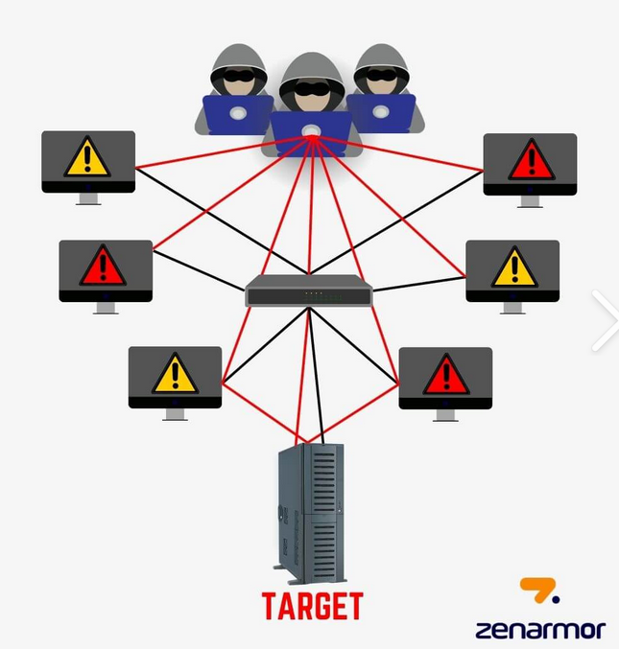
Problem Statement
Network intrusion : actions taken by attackers who exploit vulnerabilities in networks or systems to gain unauthorized access to, control over, or disrupt a target system via network connections.
More specifically, it typically manifests as:
  Disguising malicious traffic as legitimate traffic to bypass security measures and gain access to the system (unauthorized access).
  Performing malicious operations within the network (stealing data, planting backdoors, lateral movement, denial of service, etc.).
  The traffic patterns may be similar to normal business traffic, or even constantly changing (zero-day/new variants).

Slide 5
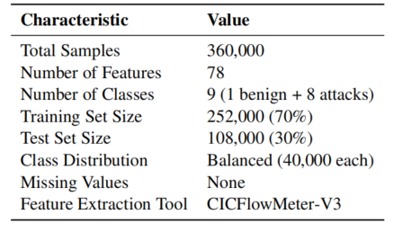
Dataset
CSE-CIC-IDS2018
Created collaboratively by the Canadian Institute for Cybersecurity (CIC) and the Communications Security Establishment (CSE)
To facilitate model comparison and reduce computational requirements, we utilized a cleaned and bal_x0002_anced subset of the original dataset
The dataset comprises one benign class representing normal network traffic and eight distinct attack types representing various cyber threats.

Slide 6
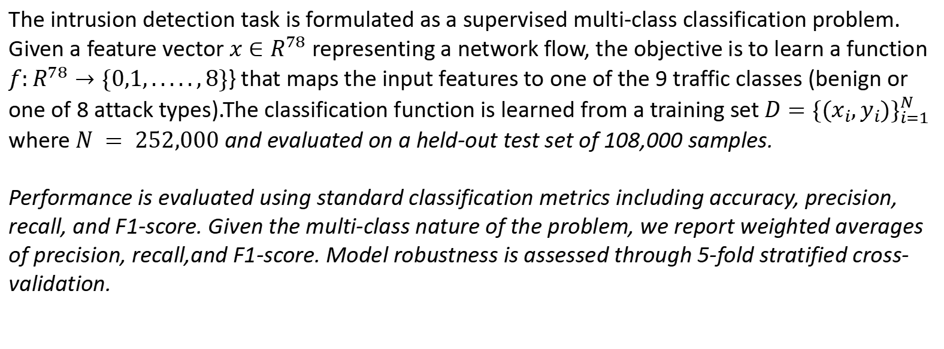

Problem Formulation

Slide 7
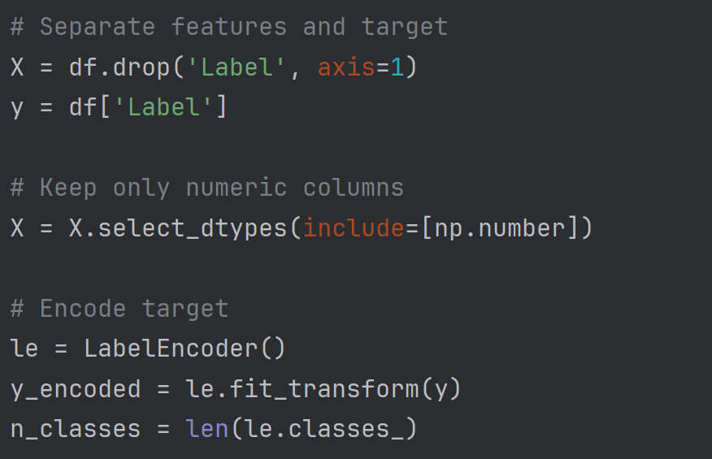
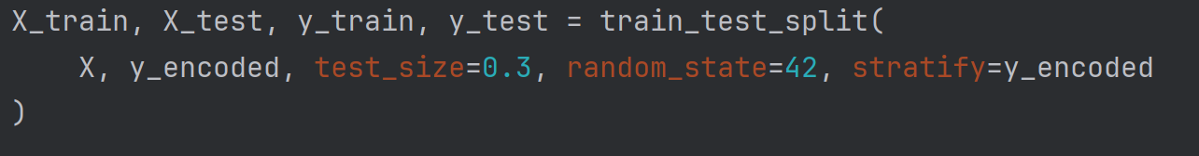
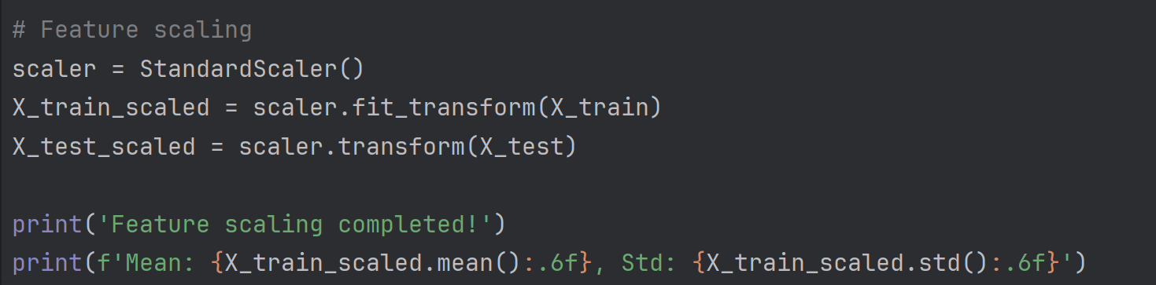
Data processing
Data inspection results: No missing values ​​were found, therefore no imputation is needed; infinite values ​​that might arise from feature calculations were also checked and none were detected in this dataset.
Data splitting: Stratified sampling was used to maintain class proportions, with 70% for training (252,000 samples) and 30% for testing (108,000 samples).
Feature scaling: Standardization was used to transform each feature to have zero mean and unit variance.

Slide 8
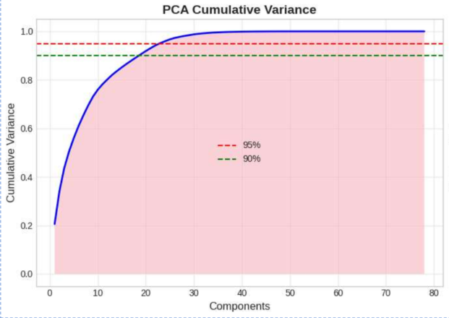
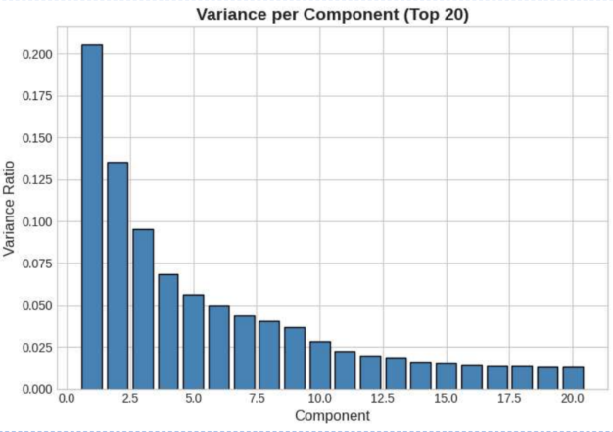
Dimensionality Analysis
Principal Component Analysis (PCA) was applied to examine the intrinsic dimensionality of the feature space and assess potential for dimensionality reduction.
The analysis reveals that approximately 23 principal components are required to capture 95% of the total variance, while 19 components sufficefor 90%.
The first two components alone explain only 34.09% of variance (20.56% and 13.53% respectively), indicating that the data exhibits complex structure not easily captured by linear projections. Table 5 summarizes the PCA results.

Slide 9
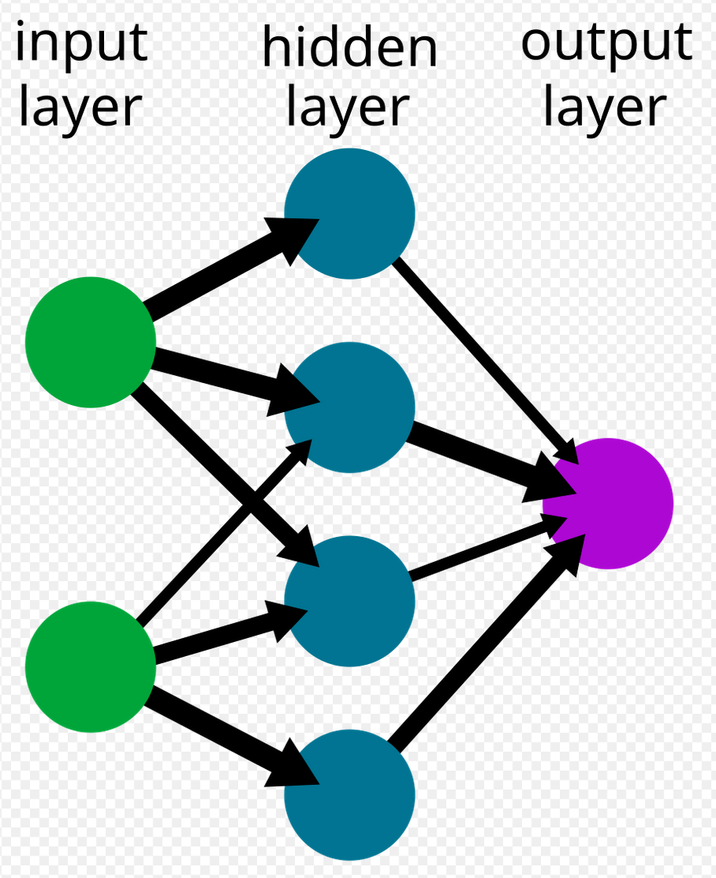
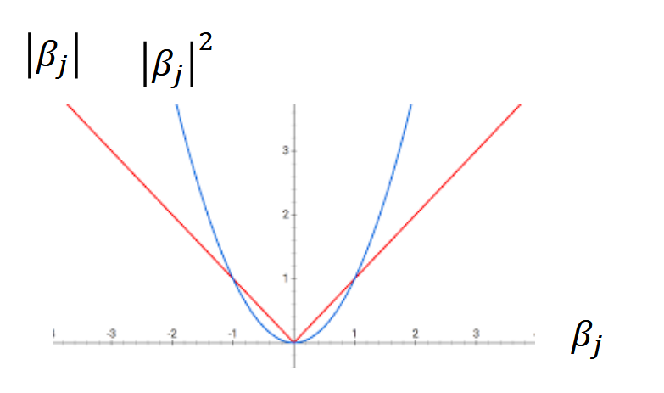
Logistic Regression & Neural Network
Notes:
A Multi-Layer Perceptron (MLP) with three hidden layers (128, 64, and 32 neurons) was implemented using ReLU activations.
The network was trained using the Adam optimizer with initial learning rate 0.001, batch size 256, and L2 regularization coefficient 0.0001. Early stopping with patience of 10 epochs prevented overfitting by monitoring validation loss

Slide 10
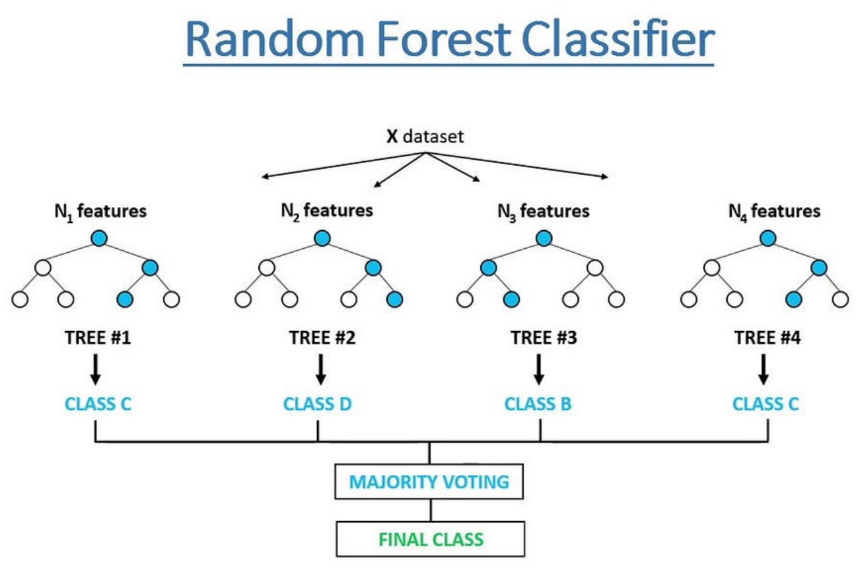
Random Forest
Random Forest constructs an ensemble of decision trees, each trained on a bootstrap sample of the data with random feature subsets considered at each split. Final predictions are made by majority voting across trees.
This approach reduces overfitting through averaging and provides natural estimates of feature importance.
We configured 100 trees with maximum depth 20 and minimum samples for splitting set to 5.

Slide 11
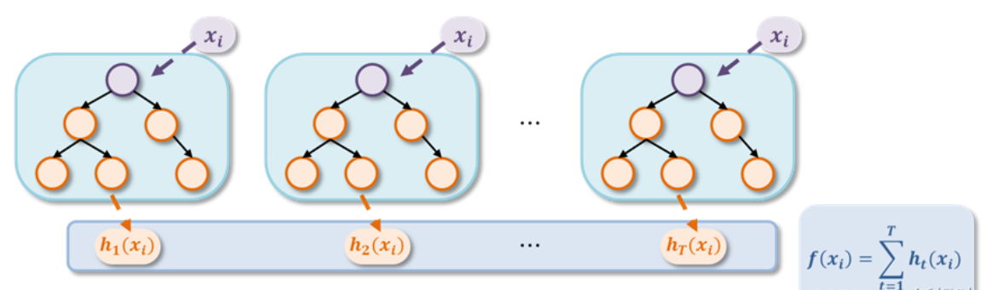
XGBoost
XGBoost implements gradient boosting with regularized objective functions and efficient tree construction algorithms.
The model iteratively adds trees that minimize a differentiable loss function, with each tree fitted to the residuals of the current ensemble.
We used 100 estimators with maximum depth 10,learning rate 0.1, and subsampling rate 0.8 for both samples and features.

Slide 12
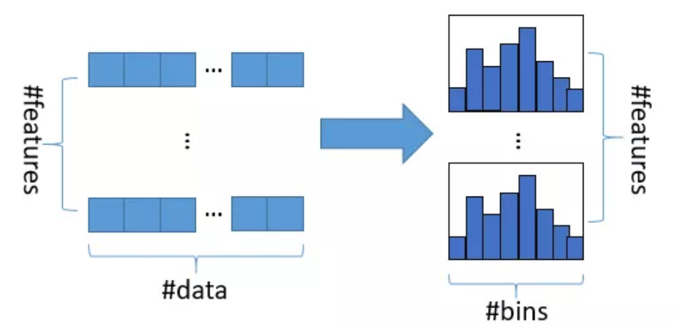
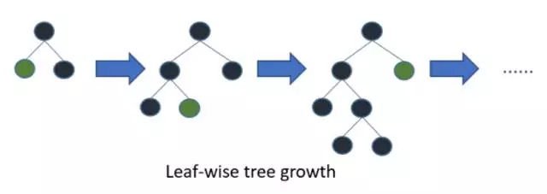
LightGBM
LightGBM employs histogram-based algorithms and leaf-wise tree growth that significantly accelerate training compared to traditional gradient boosting implementations.
The gradient-based one-side sampling (GOSS) and exclusive feature bundling (EFB) techniques enable efficient handling of large-scale datasets.
Configuration matched XGBoost with 100 estimators, maximum depth 10, and learning rate 0.1.

Slide 13
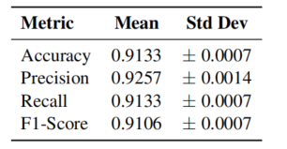
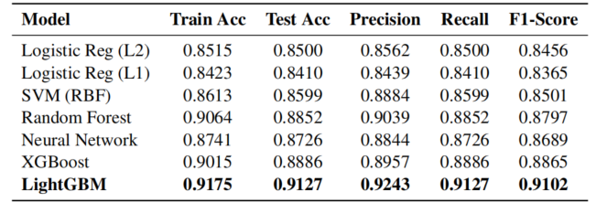
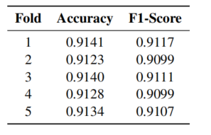
Overall Model Performance & Cross-Validation Results
Notes:
LightGBM achieved the highest test accuracy of 91.27%, substantially outperforming all other models.XGBoost and Random Forest followed with test accuracies of 88.86% and 88.52% respectively. The linear models (Logistic Regression variants) showed the lowest performance, with test accuracies around 84-85%, indicating that the classification problem requires non-linear decision boundaries that linear models cannot adequately capture. SVM with RBF kernel achieved 85.99% accuracy, demonstrating the benefit of non-linear transformations but not matching the performance of ensemble methods.
To assess model stability and generalization, we performed 5-fold stratified cross-validation using LightGBM (the best-performing model).
The extremely low standard deviations (less than 0.002 for all metrics) indicate highly stable performance across different data partitions, suggesting the model generalizes well and is not sensitive to the particular training/test split.

Slide 14
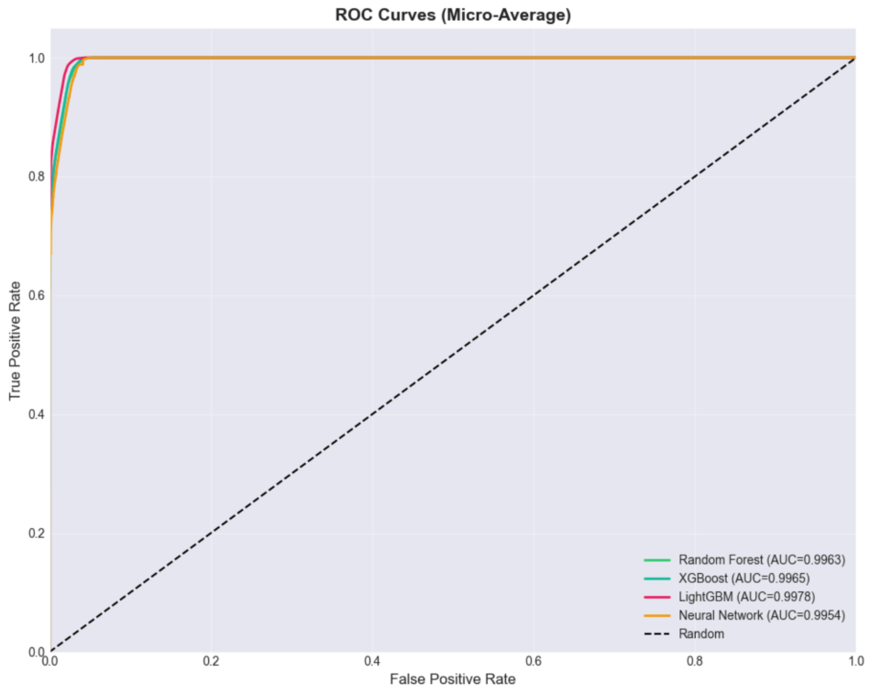
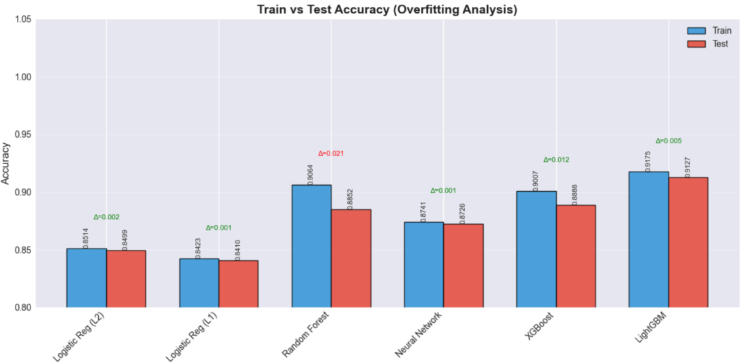
ROC-AUC Analysis &Overfitting Analysis
Notes:
We presents the micro-averaged Area Under ROC Curve (AUC) for models supporting probability predictions.
All evaluated models achieve excellent AUC scores above 0.99, indicating strong discriminative ability across different classification thresholds.
We compares training and test accuracy for each model to assess potential overfitting. The gap (∆)between training and test accuracy indicates the degree of overfitting.
Linear models (Logistic Regression variants), SVM, and Neural Network show minimal generalization gap (∆ ≈ 0.001−0.002), indicating no overfitting. Random Forest exhibits the largest gap (∆ = 0.021),suggesting slight overfitting despite its strong test performance.
XGBoost (∆ = 0.013) and LightGBM(∆ = 0.005) show moderate to excellent generalization, with LightGBM achieving the best balance between training performance and generalization.

Slide 15
Conclusion
Main Findings: Our group conducted a comparative study of 7 machine learning models for network intrusion detection on the CSE-CIC-IDS2018 dataset. Gradient Boosting models, especially LightGBM, achieved the best overall performance with 91.27% test accuracy and F1 score of 0.9102. Most attack types (Bot, DDoS-HOIC, DoS-Hulk, SSH-BruteForce) were detected with near-perfect recall.
Limitations: Slow-rate DoS (SlowHTTPTest) attacks remain difficult: Only 54% recall, due to strong similarity to legitimate long-duration connections. The dataset is balanced and static, which does not reflect real-world traffic imbalance or evolving attack behaviors. Moreover, it has limited coverage of emerging and unseen attack variants
Future Work: Exploring ensemble methods and temporal models (CNNs/RNNs) to improve detection of complex traffic patterns. Adversarial robustness and real-time deployment constraints such as latency, throughput, and resource usage will also be evaluated.

Slide 16
Reference
[1] Lee, W., & Stolfo, S. J. (2000). A framework for constructing features and models for intrusion detection systems. ACM Transactions on Information and System Security, 3(4), 227-261. https: //doi.org/10.1145/382912.382914
[2] Tavallaee, M., Bagheri, E., Lu, W., & Ghorbani, A. A. (2009). A detailed analysis of the KDD CUP99data set. IEEE Symposium on Computational Intelligence for Security and Defense Appli cations, 1-6. https://doi.org/10.1109/CISDA.2009.5356528
[3] Mukkamala, S., Janoski, G., & Sung, A. (2002). Intrusion detection using neural networks and support vector machines. Proceedings of the International Joint Conference on Neural Networks, 1702-1707. https://doi.org/10.1109/IJCNN.2002.1007774 15
[4] Zhang, J., Zulkernine, M., & Haque, A. (2008). Random-forests-based network intrusion detection systems. IEEE Transactions on Systems, Man, and Cybernetics, 38(5), 649-659. https://doi. org/10.1109/TSMCC.2008.923876
[5] Sharafaldin, I., Lashkari, A. H., & Ghorbani, A. A. (2018). Toward generating a new intrusion de tection dataset and intrusion traffic characterization. 4th International Conference on Information Systems Security and Privacy (ICISSP), 108-116. https://www.unb.ca/cic/datasets/ ids-2018.html
[6] Chen, T., & Guestrin, C. (2016). XGBoost: A scalable tree boosting system. Proceedings of the 22nd ACM SIGKDD International Conference on Knowledge Discovery and Data Mining, 785 794. https://doi.org/10.1145/2939672.2939785

Slide 17
Reference
[7] Ke, G., Meng, Q., Finley, T., Wang, T., Chen, W., Ma, W., Ye, Q., & Liu, T. Y. (2017). LightGBM: A highly efficient gradient boosting decision tree. Advances in Neu ral Information Processing Systems, 30, 3146-3154. https://papers.nips.cc/paper/ 6907-lightgbm-a-highly-efficient-gradient-boosting-decision-tree
[8] Dhaliwal, S. S., Nahid, A. A., & Abbas, R. (2018). Effective intrusion detection system using XGBoost. Information, 9(7), 149. https://doi.org/10.3390/info9070149
[9] Leevy, J. L., & Khoshgoftaar, T. M. (2020). A survey and analysis of intrusion detection models based on CSE-CIC-IDS2018 Big Data. Journal of Big Data, 7, 104. https://doi.org/10. 1186/s40537-020-00382-x
[10] Goodfellow, I., Bengio, Y., & Courville, A. (2016). Deep Learning. MIT Press. https://www. deeplearningbook.org/
[11] Pedregosa, F., Varoquaux, G., Gramfort, A., Michel, V., Thirion, B., Grisel, O., ... & Duchesnay, E. (2011). Scikit-learn: Machine learning in Python. Journal of Machine Learning Research, 12, 2825-2830. https://jmlr.org/papers/v12/pedregosa11a.html
[12] Buczak, A. L., & Guven, E. (2016). A survey of data mining and machine learning methods for cyber security intrusion detection. IEEE Communications Surveys & Tutorials, 18(2), 1153-1176. https://doi.org/10.1109/COMST.2015.2494502

